Slide 1
NO CHILD LEFT BEHIND
Families not institutions –
EU external action championing children’s rights

Slide 2
INTRODUCTION AND OPENING REMARKS
Irena ANDRASSY, Deputy Head of Cabinet for Commissioner Mimica
Martina & Maicol, Youth representatives, Emerging Global Leaders Summit
Georgette MULHEIR, CEO, Lumos

Slide 3
NO CHILD LEFT BEHIND
(Chair) Georgette MULHEIR, CEO, Lumos
Neven MIMICA, European Commissioner for International Cooperation and Development
Christos STYLIANIDES, European Commissioner for Humanitarian Aid & Crisis Management
J.K. ROWLING, author, Founder and Life President Lumos

Slide 4
JOINING FORCES TO END INSTITUTIONALISATION
GEORGETTE MULHEIR, CEO, LUMOS

Slide 5
JOINING FORCES TO
END INSTITUTIONALISATION

Slide 6
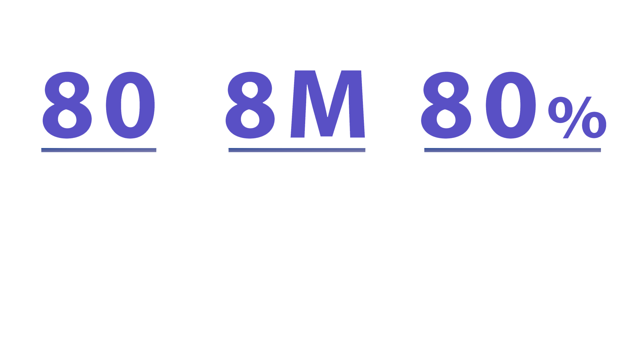
THE BIG PICTURE
80 years of research proves that institutions severely harm children
8 million children and young people live in institutions worldwide
80% of children in orphanages have a living parent

Slide 7
WHY IS IT STILL HAPPENING?
BELIEF
INERTIA
MONEY
VESTED INTERESTS
LACK OF CAPACITY
LACK OF AWARENESS

Slide 8




2009
RATE OF
INSTITUTIONALISATION
MORTALITY
THE COSTS INVOLVED
BULGARIA
6,730
€
24
CHILDREN
PER YEAR
CHILDREN IN INSTITUTIONS
ONE OF THE HIGHEST RATES OF INSTITUTIONALISATION IN THE EU
€5,830
AMONG THE HIGHEST MORTALITY RATES IN THE EU
2010 ANNUAL COST PER CHILD OF AN INSTITUTIONAL CARE PLACEMENT
EUROPEAN
COMMISSION
CIVIL SOCIETY
GOVERNMENT
87%
JOIN FORCES TO CREATE A NATIONAL VISION AND ACTION PLAN
€1,370
REDUCTION.
ALL INSTITUTIONS FOR CHILDREN WITH DISABILITIES CLOSED
2017 ANNUAL COST PER CHILD OF
FAMILY SUPPORT SERVICE
2017
REDUCED TO
3 PER YEAR

Slide 9




2003
SUDAN
OUTCOME
WHY?
DESTINY
NATIONAL
CHANGE
50%
COMMUNITY
1000
BABIES LEFT ON THE STREETS
GOVERNMENT
50% DIE ON THE STREET
CIVIL SOCIETY
BORN OUTSIDE MARRIAGE
UNICEF, MSF
SINGLE MOTHERS DECRIMINALISED
SUPREME RELIGIOUS COUNCIL
JOIN FORCES TO CREATE A PROGRAMME OF NATIONAL CHANGE
50% SENT TO MAYGOMA OPRHANAGE
4000
3000
PUNISHED UNDER SHARIA LAW
CHILDREN IN ADOPTIVE FAMILIES
CHILDREN IN BIRTH FAMILIES
82% MORTALITY RATE
COST PER CHILD = $3,300
COST PER CHILD = $1,200

Slide 10


HAITI
COSTS
OUTCOMES TO DATE
EMERGING
PRACTICE
$100 M
5
ESTIMATED 30,000 CHILDREN LIVE IN APPROXIMATELY 750 ORPHANAGES
!
DONATED TO HAITIAN ORPHANAGES ANNUALY
INSTITUTIONS
CLOSED
GOVERNMENT
SEVERE ABUSE AND NEGLECT
EUROPEAN
COMMISSION
75%
PARENTS PLACE CHILDREN IN THE HOPE OF EDUCATION
U.S. GOVERNMENT
OF CHILDREN SUCCESSFULLY REUNITED WITH THEIR FAMILIES
CIVIL SOCIETY
85% UNREGISTERED
DRIVEN BY VOLUNTOURISM
JOIN FORCES TO CREATE A PLAN TO TRANSFORM CARE AND END TRAFFICKING
389
$100 M
PEOPLE TRAINED - SOCIAL WORKERS, POLICE OFFICERS, JUDGES, CIVIL SERVANTS
80%
NOT ORPHANS
MANY ARE TRAFFICKED
COULD EQUAL
770,000 CHILDREN IN SCHOOL
$

Slide 11
OUTCOMES OF INSTITUTIONAL RESPONSES TO UNACCOMPANIED REFUGEE CHILDREN
VILIFIED
PHYSICALLY ABUSED
RAPED
TRAFFICKED
SUICIDAL
INDEFINITELY DETAINED

Slide 12

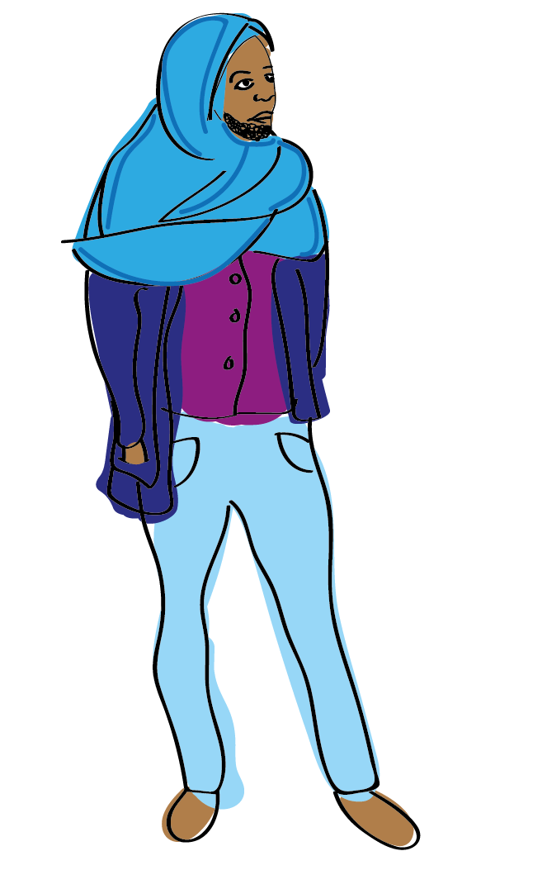
ERITREA
WITHIN THE CAMPS
A JOURNEY OF RISK & TRAUMA
JOURNEY TO LIBYA
ERITREA
ETHIOPIA
ENDABAGUNA
BORDER INSTITUTION
ADULTS:
!
80% MOVE ON WITHIN ONE YEAR
HUMAN RIGHTS
ABUSES
TRAFFICKING
CHILDREN STAY FOR
6 WEEKS
SLAVERY
CHILDREN IN SMALL GROUP HOMES:
60% MOVE ON WITHIN ONE YEAR
!
JOURNEY ACROSS THE MEDITERANEAN
EXTREMELY POOR CONDITIONS
INDEFINITE CONSPCRIPTION
NO SUPERVISION AT NIGHT
CHILDREN IN FOSTER CARE :
40% MOVE ON WITHIN ONE YEAR
ESTIMATED 200 CHILDREN DIED CROSSING THE MED IN THE FIRST 5 MONTHS OF 2017
HIGH RISK OF ABUSE
= COMPOUND TRAUMA

Slide 13
ERITREA - THE ALTERNATIVE
A VISION OF HOPE
COSTS
ERITREA
$
ETHIOPIA
ENDABAGUNA
+ SMALL GROUP HOME = $390
!
ENDABAGUNA
BORDER INSTITUTION
EMERGENCY FOSTER
CARE
HUMAN RIGHTS
ABUSES
EFC+ FC
= $340
LENGTH
OF STAY:
0 NIGHTS
FAMILY TRACING
!
FEWER CHILDREN TAKE THE DEADLY JOURNEY
CHILDREN IN CAMPS ARE PROTECTED
MORE LIKELY TO BE EDUCATED AND HAVE A BETTER FUTURE
INDEFINITE CONSPCRIPTION
KINSHIP CARE
FOSTER
CARE

Slide 14
EU LEADERSHIP IN ENDING INSTITUTIONALISATION
REDIRECT FUNDING
LEAVE NO CHILD BEHIND
CHANGE ATTITUDES
ENSURE INCLUSION
PREVENT INCARCERATION

Slide 15
LET’S JOIN FORCES TO ENSURE ALL CHILDREN CAN FLOURISH IN FAMILIES

Slide 16
STRENGTHENING CHILD PROTECTION SYSTEMS AROUND THE WORLD
(CHAIR) LOTTE KNUDSEN, MANAGING DIRECTOR, HUMAN RIGHTS, GLOBAL AND MULTILATERAL ISSUES, EUROPEAN EXTERNAL ACTION SERVICE
ZORNITSA ROUSSINOVA, DEPUTY MINISTER OF LABOUR AND SOCIAL POLICY, BULGARIA
AMBASSADOR HIS EXCELLENCY MR AMANDIN RUGIRA, AMBASSADOR OF THE REPUBLIC OF RWANDA TO BELGIUM, EU AND LUXEMBOURG
AARON GREENBERG, SENIOR REGIONAL ADVISOR FOR EUROPE AND CENTRAL ASIA, CHILD PROTECTION, UNICEF

Slide 17




Deinstitutionalization in Bulgaria – significant change in the child care system
Ms. Zornitsa Roussinova, Deputy Minister of Labour and Social Policy

Slide 18

Deinstitutionalization in Bulgaria - achievements
Reduction of the number of children in specialized institutions by 90% - from 7 587 children in 2010 to 842 in April 2018;
Reduction of the specialized institutions for children by 75% - from 137 in 2010 to 33 in April 2018;
Closing of 104 specialized institutions for children, incl. all specialized institutions for children with disabilities and for children aged 4-7 years;
Establishment of 606 community based social
services;
Measures for prevention of abandonment,
reintegration in family environment and foster care;
Integrated services for early childhood
development.

Slide 19

Updated Action Plan for the implementation of the National Strategy “Vision for Deinstitutionalization of children in the Republic of Bulgaria”
6 main groups of measures to provide:
Social and integrated services for early intervention and prevention in a family environment;
Care in a family environment for children at risk who are not raised by their biological parents;
Social services and community support for children deprived of parental care and children who are leaving the care system;
Integrated health and social services for children
with disabilities;
Effectiveness of the system to guarantee the
children’s rights;
Necessary infrastructure for the services for
children.

Slide 20



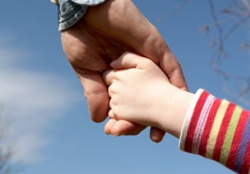
The Updated Plan foresees:
Financing of the development of 149 new services by 2025 for 7,092 users:
66 new community services and family support services for 6,262 users;
83 new residential-type services for 830 users.

Slide 21




Thank you for your attention!
Deinstitutionalization makes a change!

Slide 22



No Child Left Behind: Families not institutions
Case of Rwanda

Slide 23
Background
In 2012 Rwanda recorded 3,323 children found in 33 institutions/orphanages. More than 70% had at least one parent and/or relatives (Survey on Institution Care in Rwanda/MIGEPROF-HHC 2012)
The same year (2012) the Government of Rwanda made a commitment to reintegrate children from orphanages into family based by adopting the Strategy for National Child Care Reform with the following goals:
Supporting vulnerable families to remain together
Promoting a positive Rwandan social value: families and communities to take responsibility for every child
2013: With the support of USAID-DCOF and in partnership with UNICEF, HHC the Governement of Rwanda Launched the Tubarerere Mu Muryango Programme (Let’s raise children in Families! programme)/ TMM
The overall goals of TMM:
1. Implement the Strategy for National Child Care Reform
2. Reintegration of children in families and community care and ensure
Rwandan children are supported by a strong child protection system

Slide 24
Achievements made, challenges and wayforward
Achievements:
3127 children safely reintegrated into families from 2012 to June 2018. Among these, 62 are children with disability (CWD);
Establishment of various mechanisms to ensure sustainable placements, prevention and response to child protection concerns :
Programme Coordination Team comprised of public institutions and NGOs
  Establishment of a professional social workforce comprised of social workers and psychologists
  Establishment of community-based child protection volunteers (29,674) known as “Inshuti z’Umuryango” (Friends of the Family) and recruitment, training and accreditation of Foster Care Givers
Challenges and Way forward: There are limited services and skilled for workforce to provide services to CWD however moving forward there is a plan to engage in modeling reintegration of CWD in two institutions and hope to scale up.

Slide 25
Children placed by type of placement

Slide 26
“The reintegration of thousands orphans into foster or an adoptive family was a success thanks to country’s tradition to recognize a child as a product of the whole society”
Said by First Lady Jeannette Kagame during the Global First Ladies Alliance gathered in New York in September, 2017

Slide 27
THANK YOU!

Slide 28
LUNCH

Slide 29
THE HUMAN AND FINANCIAL COST OF INSTITUTIONALISATION
PROF. CHARLES ZEANAH, MARY SELLARS-POLCHOW CHAIR IN PSYCHIATRY; VICE CHAIR, CHILD & ADOLESCENT PSYCHIATRY, TULANE UNIVERSITY SCHOOL OF MEDICINE (VIA FILM)
PROF. MANFRED NOWAK, INDEPENDENT EXPERT LEADING THE UN GLOBAL STUDY CHILDREN DEPRIVED OF LIBERTY
MIHAELA IVANOVA, SELF-ADVOCATE, REPRESENTATIVE, EMERGING GLOBAL LEADERS SUMMIT

Slide 30
THE HUMAN AND FINANCIAL COST OF INSTITUTIONALISATION
PROF. CHARLES ZEANAH, MARY SELLARS-POLCHOW CHAIR IN PSYCHIATRY; VICE CHAIR, CHILD & ADOLESCENT PSYCHIATRY, TULANE UNIVERSITY SCHOOL OF MEDICINE (VIA FILM)
PROF. MANFRED NOWAK, INDEPENDENT EXPERT LEADING THE UN GLOBAL STUDY CHILDREN DEPRIVED OF LIBERTY
MIHAELA IVANOVA, SELF-ADVOCATE, REPRESENTATIVE, EMERGING GLOBAL LEADERS SUMMIT

Slide 31
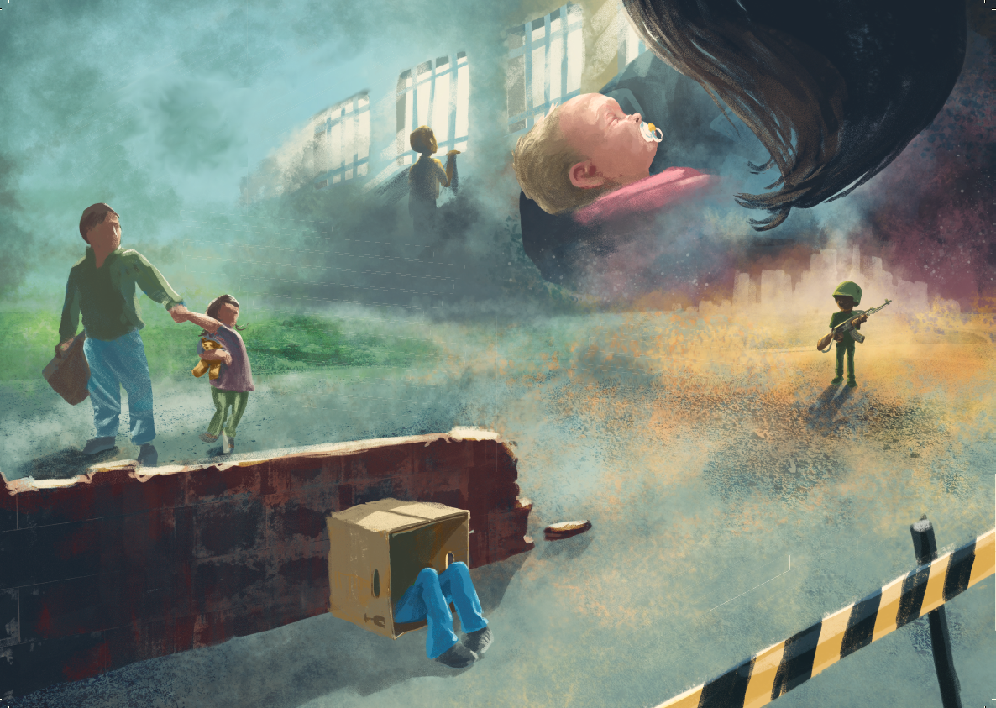



The Global Study on Children Deprived of Liberty and Institutionalisation
No Child Left Behind: Families not institutions
EU external action championing children’s rights
Brussels, 15 June 2018
MANFRED NOWAK
Independent Expert leading the UN Global Study on Children Deprived of Liberty
Professor of International Human Rights, University of Vienna
Director of the Ludwig Boltzmann Institute of Human Rights
Secretary General of European Inter-University Centre
for Human Rights and Democratisation, Venice

Slide 32
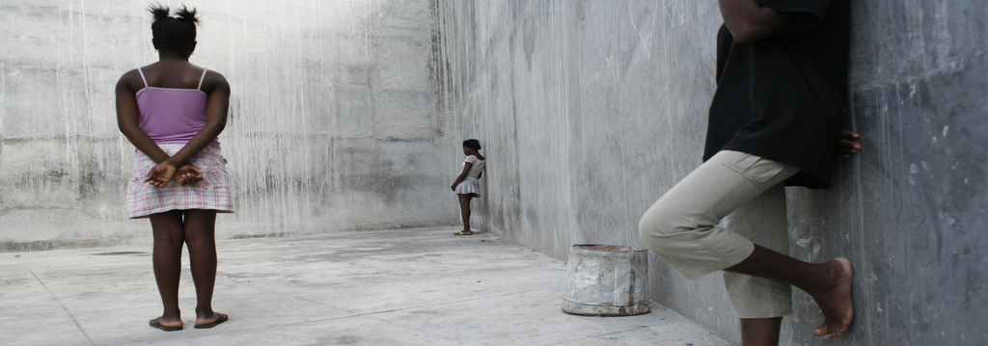
Background
1996: UN Report on the Impact of Armed Conflict on Children by Graça Machel leading to the appointment of a Special Representative of the Secretary-General on Children in Armed Conflict, Leila Zerrougui (2012-2017), Virginia Gamba (since 2017);
2006: United Nations Study on Violence against Children by Paulo Sérgio Pinheiro leading to the appointment of a Special Representative of the Secretary-General on Violence Against Children, Marta Santos Pais
General Assembly Resolution 69/157 of 18 December 2014:
invited the UN Secretary-General to commission an in-depth Global Study on Children Deprived of Liberty
25 October 2016: Manfred Nowak was appointed
as Independent Expert leading the Global Study

Slide 33
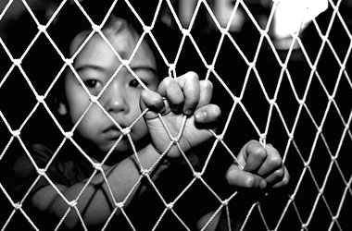
Why a UN Global Study on Children Deprived of Liberty?
UN Convention on the Rights of the Child: Deprivation of Liberty of Children only as a measure of last resort, and in exceptional circumstances if absolutely necessary, only for the shortest period of time.
In reality, far too many children are detained in prisons, pre-trial detention centres, police lock-ups, children’s homes, orphanages or other closed institutions for refugee and migrant children, child soldiers or children accused of terrorism.
Still, there is no reliable statistical data on the number of children deprived of liberty and we lack information on the reasons for their detention as well as on alternative measures for the purpose of de-institutionalization and reducing the number of children deprived of liberty.
Childhood is a formative time in everyones life. Putting children behind bars and depriving them of their right to personal liberty leaves a deep mark – in their lives and in society.

Slide 34
Main Objectives of the Global Study
To assess the magnitude of this phenomenon, including the number of children deprived of liberty (disaggregated by age and gender), as well as the reasons invoked, the root-causes, type and length of deprivation of liberty and places of detention
To document good practices and experiences and to capture the views and experiences of children to inform the Global Study’s recommendations
To raise awareness and promote a change in stigmatizing attitudes and behaviour towards children at risk of arrest or detention as well as children who are deprived of liberty
To provide recommendations for law, policy and practice to safeguard the rights of children concerned, prevent the detention of children and significantly reduce the number of children deprived of liberty through effective non-custodial alternatives guided by the best interests of the child

Slide 35
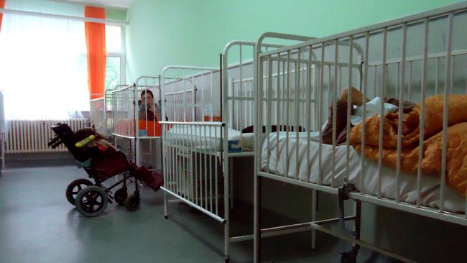
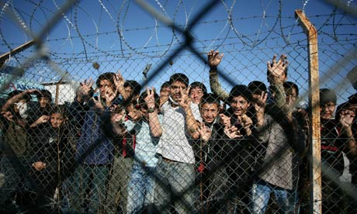
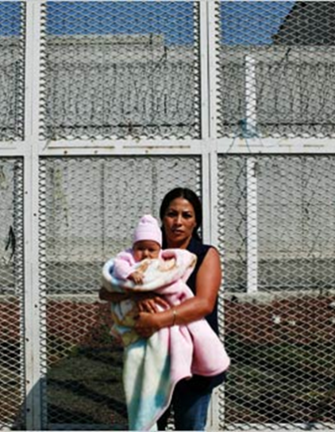
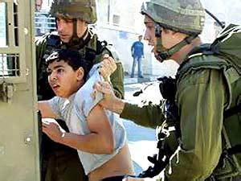
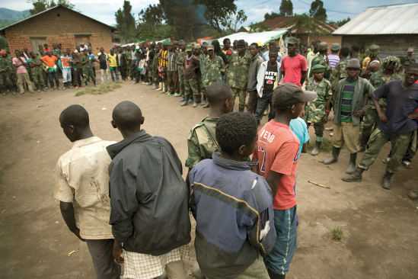
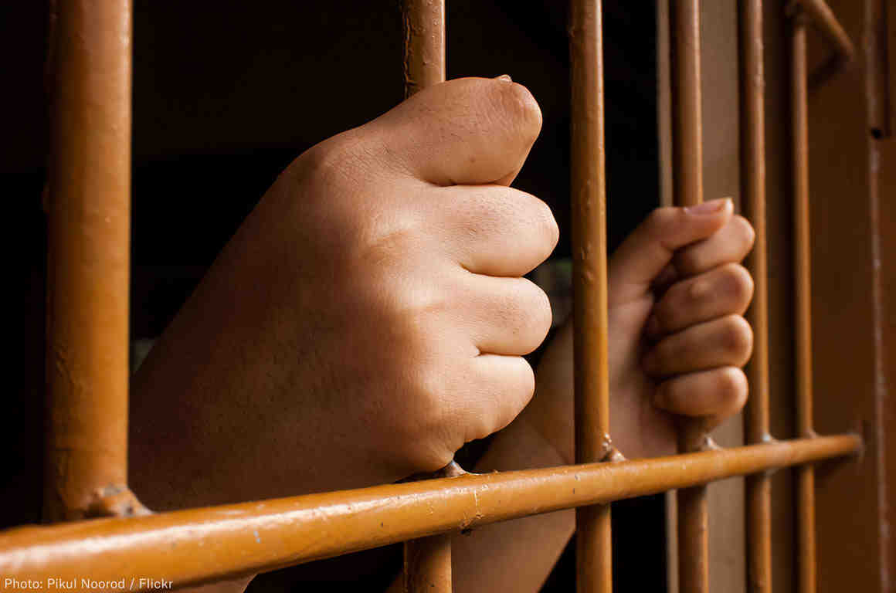
Key Focus Areas
Children deprived of liberty in institutions
Children deprived of liberty for migration-related reasons
Children deprived of liberty on national security grounds
Children living in places of detention with their parents
Children deprived of liberty in the context of armed conflict
Children deprived of liberty within the administration of justice

Slide 36
Deprivation of Liberty in Institutions
“Institutions” in the sense of the Global Study = all public or private settings outside the justice system or the penitentiary administration, where children can be deprived of liberty. Such institutions may include, but are not limited to, orphanages, reform schools, closed remand rooms or other correctional institutions, institutions for children with disabilities, for children with health problems (e.g. facilities dealing with behavioural disorders, psychiatric facilities), for children with drug, alcohol or other addictions, for the protection of victims of abuse including trafficking, for children without parental care.
Not every child living in an institution is deprived of liberty. However, institutions have the potential to restrict various human rights, e.g. right to privacy and various freedoms, including the right to personal liberty.
The global trend towards de-institutionalisation contributes to reducing the number of children deprived of liberty.

Slide 37
Thank you for your attention!
Together, we will make the Global Study a success, reduce the number of children deprived of liberty and impact their lives for the better!

Slide 38
Emerging Responses
(CHAIR) CECILE KYENGE, MEP, VICE CHAIR OF THE DELEGATION TO THE ACP-EU JOINT PARLIAMENTARY ASSEMBLY
HRH PRINCE MIRED RAAD ZEID AL-HUSSEIN, PRESIDENT OF THE HIGHER COUNCIL FOR THE RIGHTS OF PERSONS WITH DISABILITIES (HCD), JORDAN
MYRIA VASSILIADOU, EU ANTI-TRAFFICKING COORDINATOR
SOPHIE MAGENNIS, OFFICER IN CHARGE, UNHCR REGIONAL REPRESENTATION FOR EU AFFAIRS

Slide 39
Vision & Commitments
(CHAIR) GEORGETTE MULHEIR, CEO, LUMOS
MICHAEL, FROM HAITI, YOUTH RAPPORTEUR, EMERGING GLOBAL LEADERS SUMMIT
NEVEN MIMICA, EUROPEAN COMMISSIONER FOR INTERNATIONAL COOPERATION AND DEVELOPMENT
J.K. ROWLING, AUTHOR, FOUNDER AND LIFE PRESIDENT LUMOS
GEORGETTE MULHEIR ROUNDUP
ELISABETH RIEDERER, DEPUTY HEAD PSC/POL DEPARTMENT, PERMANENT REPRESENTATION OF AUSTRIA TO THE EU
PAUL D’AUCHAMP, DEPUTY REGIONAL REPRESENTATIVE FOR EUROPE, OHCHR

Slide 40
Thank you for joining us

